Slide 1

Cancer Genomics: Integrative and Scalable Solutions in R/Bioconductor
Martin Morgan (PI), Kasper Hansen, Vincent Carey, Levi Waldron (co-investigators)
May 24, 2018
@leviwaldron1
www.github.com/waldronlab
NCI ITCR #5U24CA180996
Notes:
Hi. I’d like to introduce you to MultiAssayExperiment, a framework for the representation and analysis of multi-omics experiments in Bioconductor.

Slide 2
Outline
Infrastructure produced by 5U24CA180996
Developing Bioconductor for the comprehension of complex multi’omic investigations of cancer
How my lab has used this infrastructure
How others are using this infrastructure

Slide 3
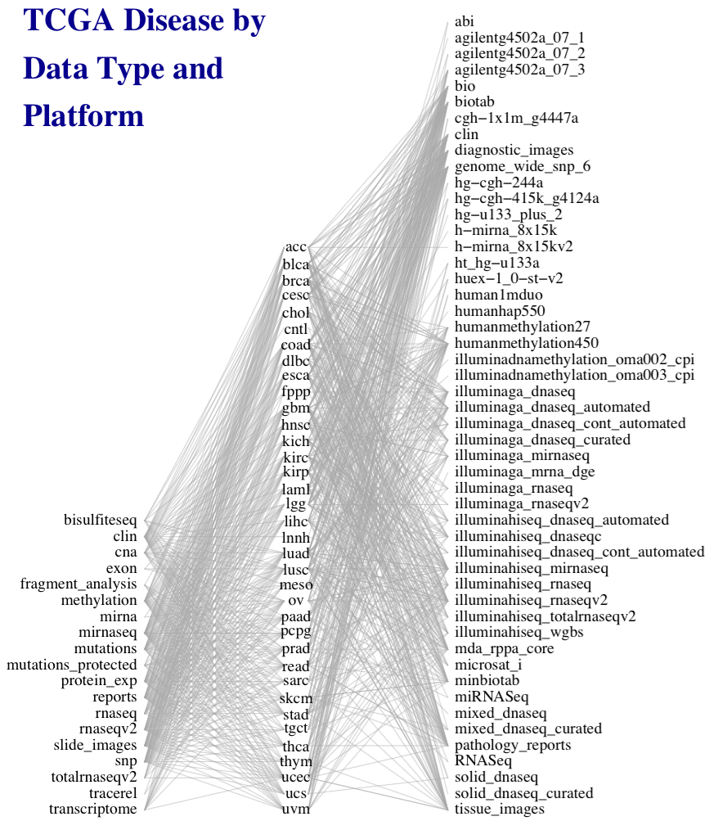
Aim 1
50 platforms
Integrative Representation and Analysis of Complex Cancer Data Sets
e.g. TCGA
33 diseases
19 data types
Credit: Marcel Ramos
Notes:
This work was motivated by the need to simplify general statistical analysis and development of bioinformatic tools for a study as complex as the Cancer Genome Atlas, where 33 cancers were assayed on many platforms to generate different types of data, but also to provide a simplified framework for more easily reproducible and less error-prone analysis of simpler experiments involving just a couple of complementary assays and clinical data.

Slide 4
The need for MultiAssayExperiment
Need a core Bioconductor data structure to:
harmonize single-assay data structures
relate multiple assays with one set of clinical data
handle missing and replicate observations
accommodate ID-based and range-based data
support on-disk representations of big data
Notes:
A core data structure was needed to
* harmonize existing structures for different types of data,
* relate assays with each other and clinical data
* handle the reality that such experiments are often incomplete and missing observations on some assays, and also may contain replicates, time series, or matched normal,
* accommodate data that are indexed by IDs such as genes and data indexed by genomic ranges,
* and support on-disk representations for big data

Slide 5
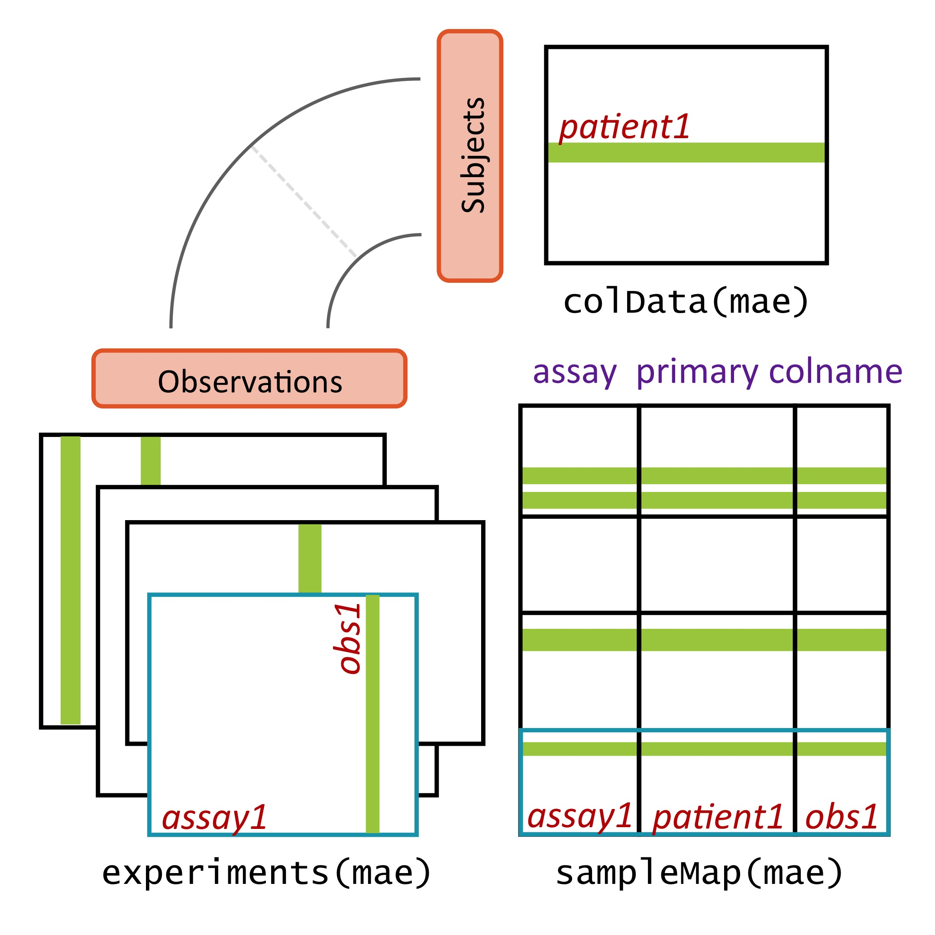
MultiAssayExperiment design
Credit: Marcel Ramos
Ramos M, Schiffer L, Re A, Azhar R, Basunia A, Rodriguez C, Chan T, Chapman P, Davis SR, Gomez-Cabrero D, Culhane AC, Haibe-Kains B, Hansen KD, Kodali H, Louis MS, Mer AS, Riester M, Morgan M, Carey V, Waldron L: Software for the Integration of Multiomics Experiments in Bioconductor. Cancer Res. 2017, 77:e39–e42.
Notes:
MultiAssayExperiment addresses these challenges by relating a table of information about subjects, say clinical and pathological data, to a series of genomic data sets of arbitrary shape and even non-tabular data, via a map or a network relating these. This sounds complex and it can be, but from the analyst’s perspective, there is an API that will be familiar to users of R, and that abstracts this complexity from the user. Constructing, accessing, subsetting, data management or manipulation, and combining and reshaping into forms usable by standard tools become straightforward.

Slide 6
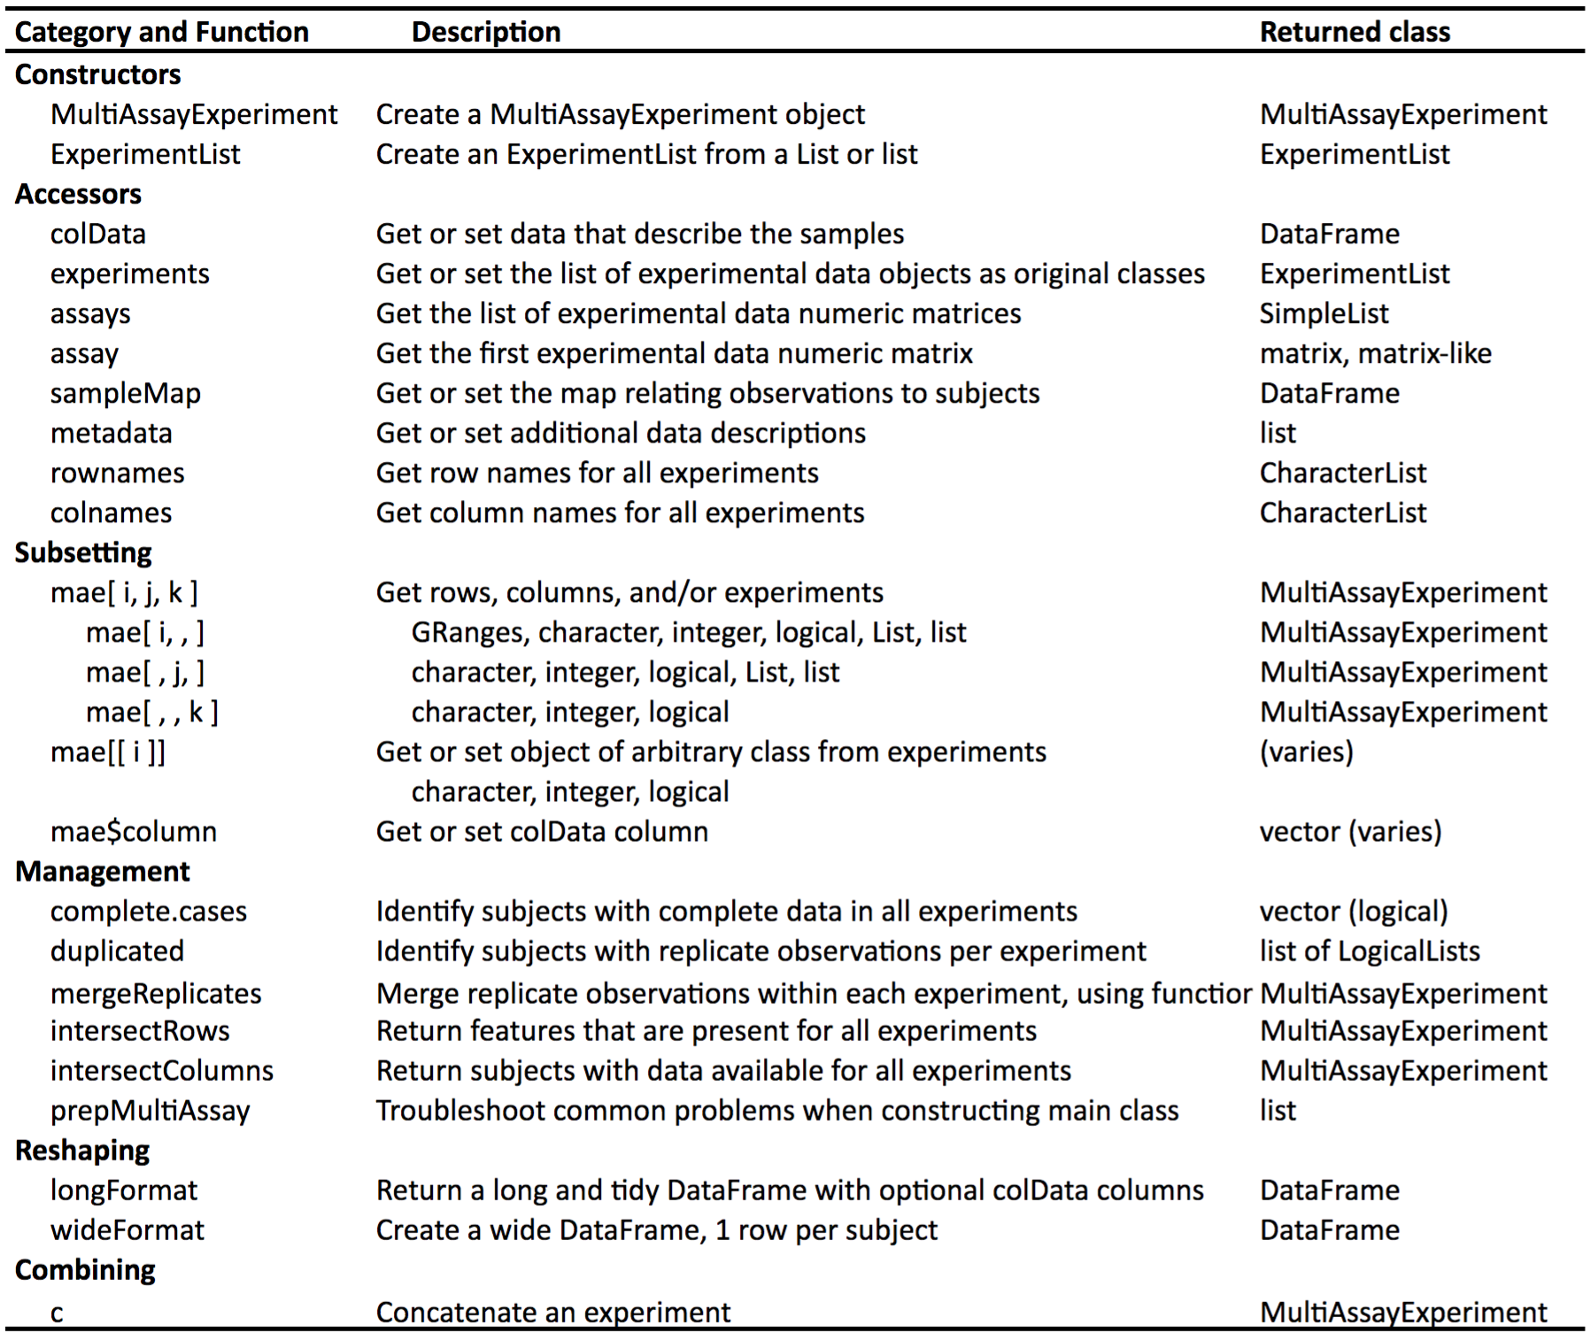
The MultiAssayExperiment API
Credit:
Marcel Ramos
Notes:
To help those wanting to analyze TCGA data, we’ve constructed MultiAssayExperiments for 33 cancer types. Each cancer type is represented by a single object containing all the most commonly used, unrestricted data. These objects are immediately usable, even on most laptops, with the API shown on the previous page.

Slide 7
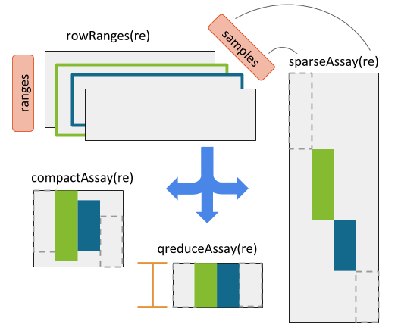
RaggedExperiment (segmented copy number, mutations)
Credit:
Marcel Ramos
Martin Morgan

Slide 8
Aim 2: data resources
curatedTCGAData
simplified pan-cancer analysis of TCGA
MultiAssayExperimentData
cBioPortal, …
curatedMetagenomicData¹
curated data for human microbiome studies
¹Pasolli E, Schiffer L, Manghi P, Renson A, Obenchain V, Truong DT, Beghini F, Malik F, Ramos M, Dowd JB, Huttenhower C, Morgan M, Segata N, Waldron L: Accessible, curated metagenomic data through ExperimentHub. Nat. Methods 2017, 14:1023–1024.

Slide 9
Aim 3: scalable infrastructure
ExperimentHub
Distribution of curatedTCGAData, etc
DelayedArray
Out-of-memory data representation using HDF5
BiocParallel
Simplified parallel evaluation

Slide 10
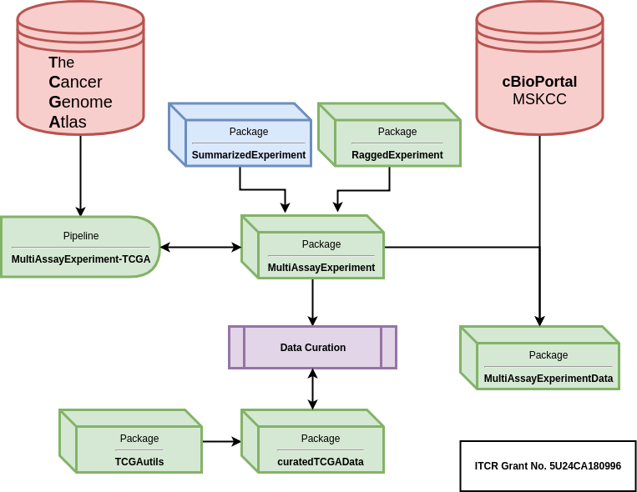
ITCR-funded multi’omics framework
Credit:
Marcel Ramos
ITCR 5U24CA180996

Slide 11
Subtype ambiguity of high-grade serous ovarian carcinoma (HGSOC)
HGSOC is a clinically homogeneous disease with widely varying outcomes
Multiple studies have “confirmed” the existence of 4 molecular subtypes
Our recent work shows most HGSOC tumors are ambiguous in their classification
Chen GM, Kannan L, Geistlinger L, Kofia V, Safikhani Z, Gendoo DMA, Parmigiani G, Birrer M, Haibe-Kains B, Waldron L: Consensus on Molecular Subtypes of Ovarian Cancer. bioRxiv 2017:162685. (In Press, Clinical Cancer Research)

Slide 12
Source of subtype ambiguity?
HGSOC is usually subclonal. Are subtypes:
evolved differently in subclones of the same tumor (“late”)?
ambiguous even in single cells (“intrinsic”)?

Slide 13
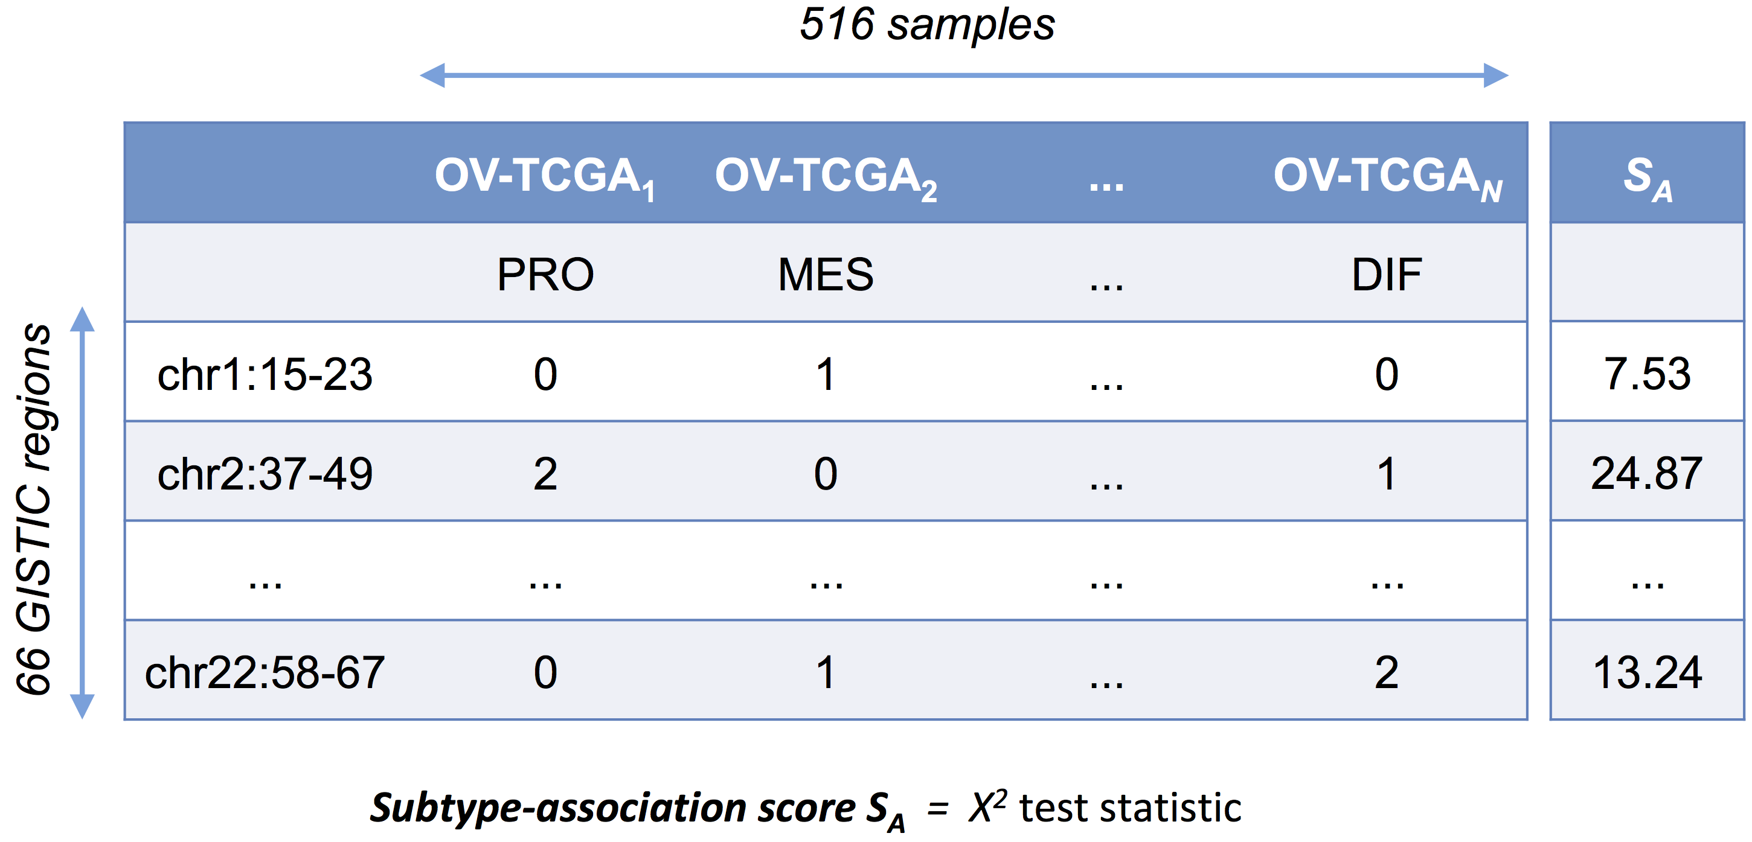
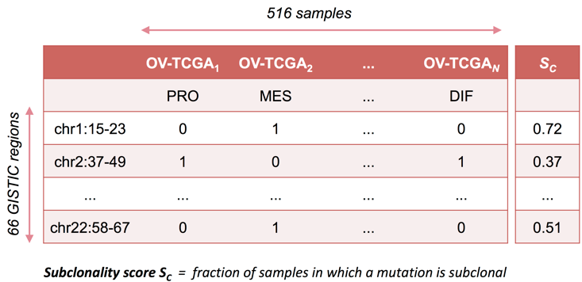
Inference from copy number and expression of bulk TCGA tumors
Absolute copy number :
expression subtype
Null hypothesis:
Subtype-associated DNA alterations occur no earlier or later than other alterations
H₀ : ρ( S_{A} , S_{C} ) = 0 ρ ... Spearman correlation
copy number subclonality :
expression subtype
Credit: Ludwig Geistlinger
Null hypothesis:
Subtype-associated DNA alterations occur no earlier or later than other alterations
H₀ : ρ( S_{A} , S_{C} ) = 0 ρ ... Spearman correlation

Slide 14
Other MultiAssayExperiment Data Resources
BiocOncoTK
TCGA PanCanAtlas
Cancer Cell Line Encyclopedia
TARGET
Conquer
Gene and Tx abundances from single-cell RNAseq

Slide 15
Software using MultiAssayExperiment
Analysis of cancer data
GOpro - Pan-cancer gene ontology analysis
omicsPrint - Cross ‘omic genetic fingerprinting
Systems biology
Hipathia - computation of signal transduction along signaling pathways
InTAD - detection of correlation between expressed genes and selected epigenomic signals, topologically associated domains (TADs)
CageR - Precise mapping of transcription start sites and promoterome mining
ELMER - Infer regulatory element landscapes and transcription factor networks from cancer methylomes
Statistical methods
ClassifyR - a framework for cross-validated classification
missRows - handling missing individuals in multi’omics data integration

Slide 16


Thank you
ITCR #5U24CA180996 Collaborators (shortlist)
Martin Morgan, Vincent Carey, Kasper Hansen
Valerie Obenchain, Lori Shepherd
Lab
Ludwig Geistlinger, PhD
Lucas Schiffer, MPH
@_schifferl
@schifferl
@lgeistlinger
Sehyun Oh, PhD
Marcel Ramos, MPH
@shbrief
@M2RUseR
@LiNk-NY
Slides: https://tinyurl.com/LWITCR2018
Notes:
met Jin Xu from East China Normal University, Shanghai

